Slide 1

Enhanced intrusion detection system with deep learning
Mohab Sameh Ibrahim Abdel-Wahab
Supervised by: Dr. Ayman Ezzat
20, July 2020

Slide 2
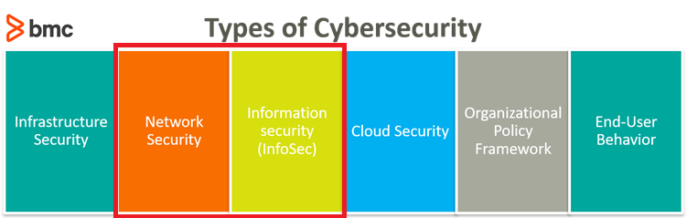
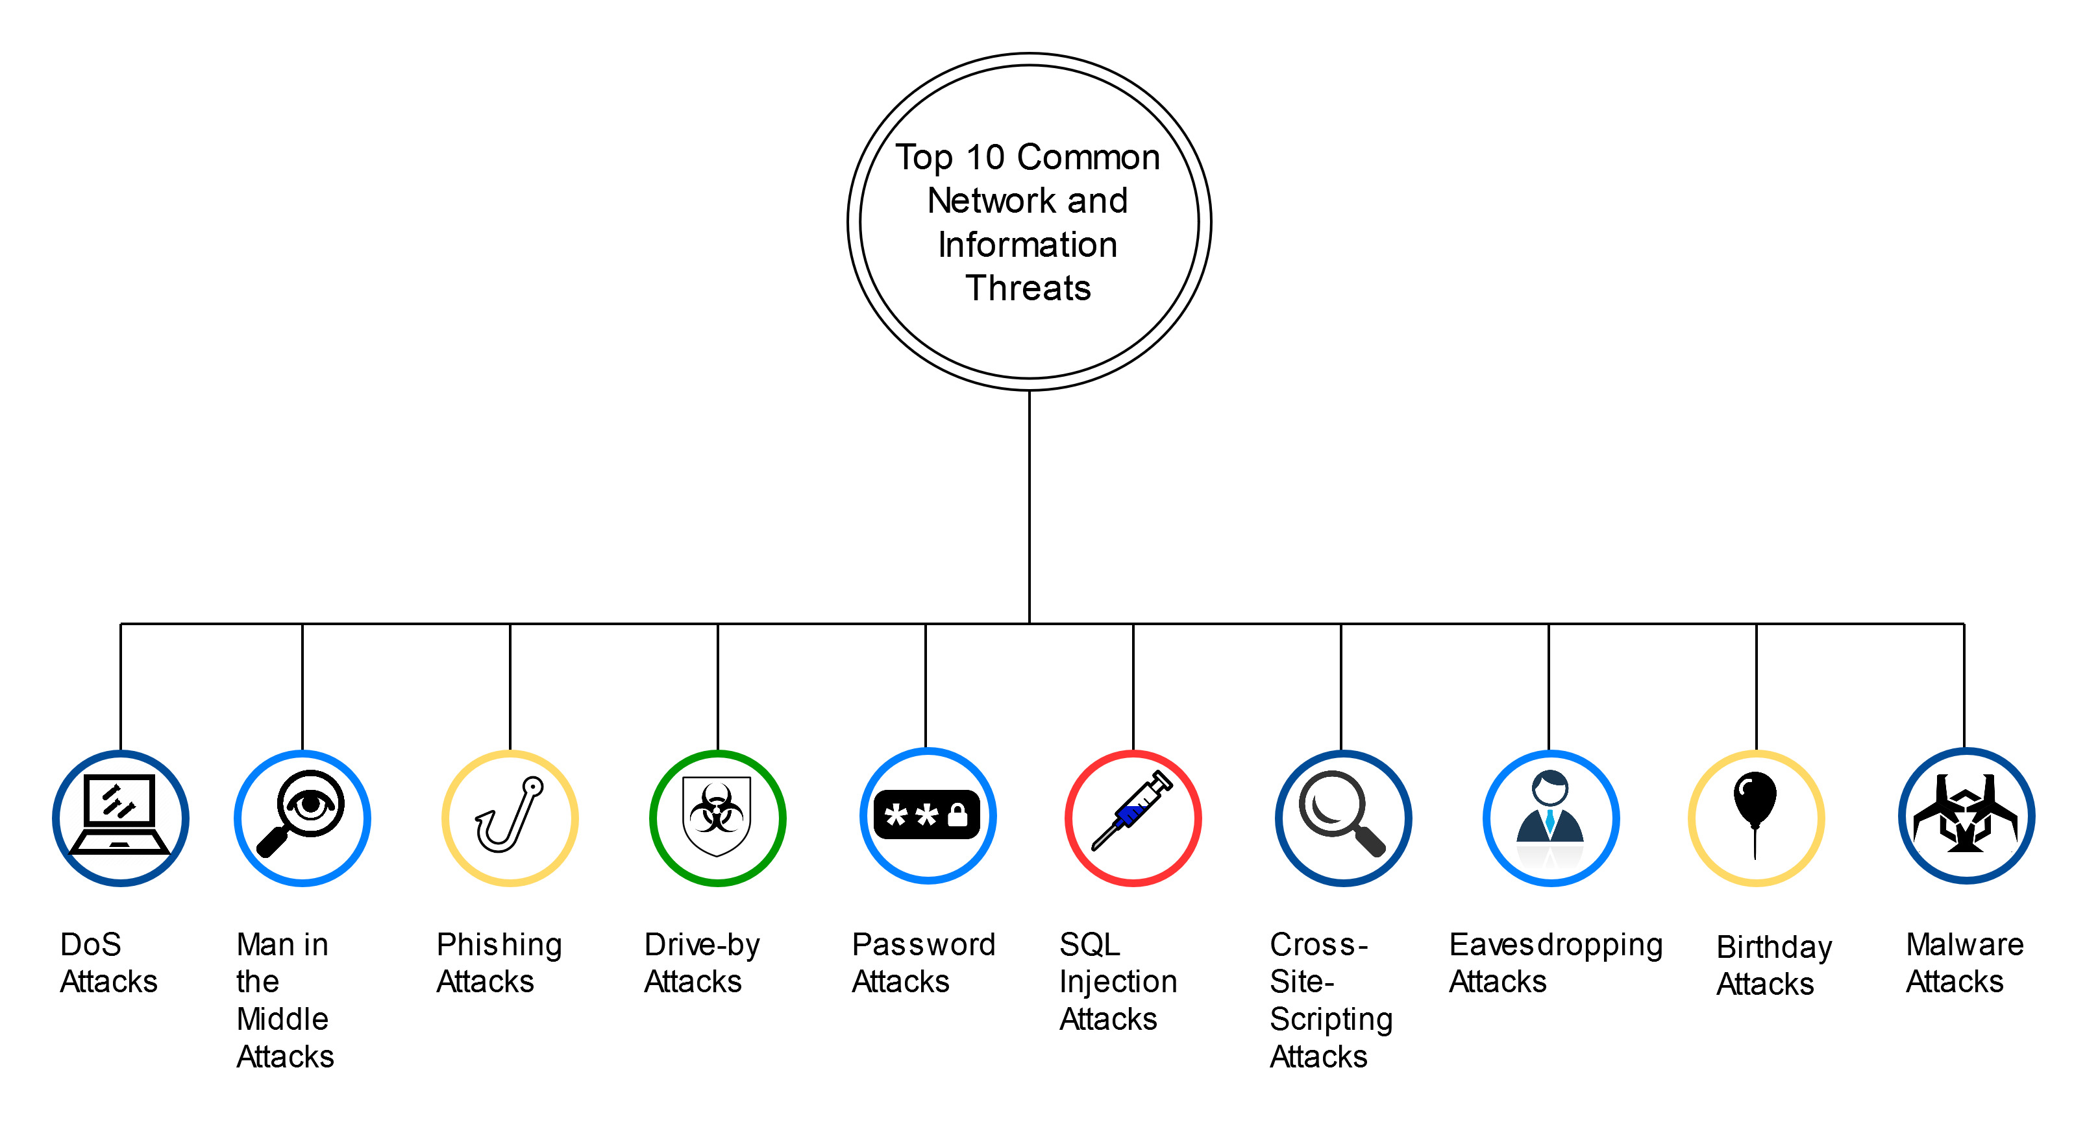
Intro (1/2)
Cybersecurity -> Defending Computers, mobile devices, etc. from malicious attacks.
Potential Network & Information Threats

Slide 3
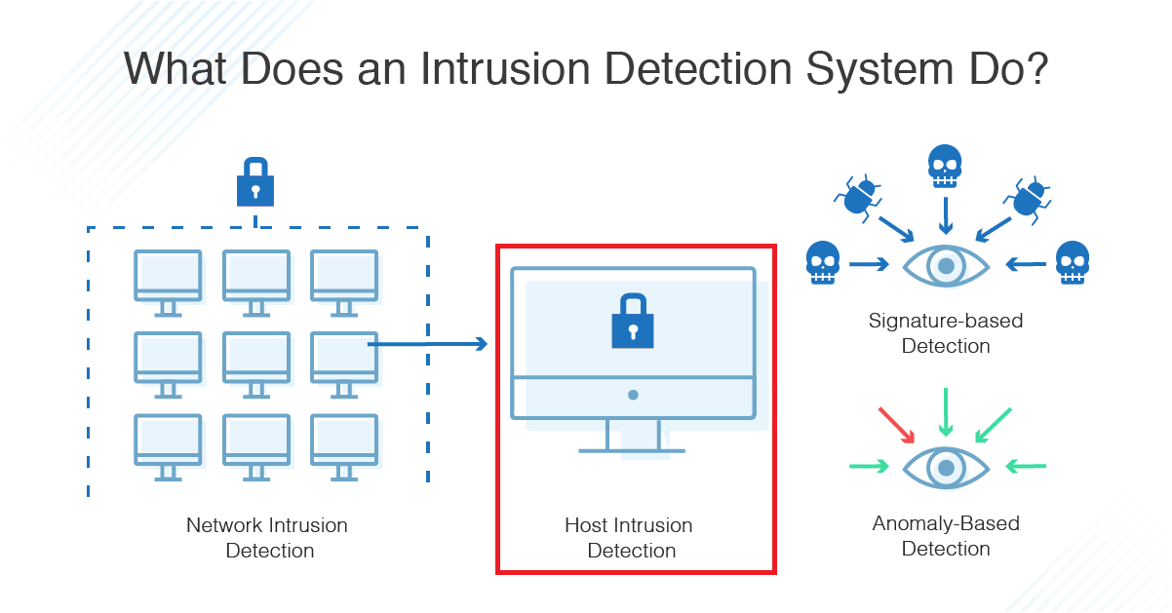
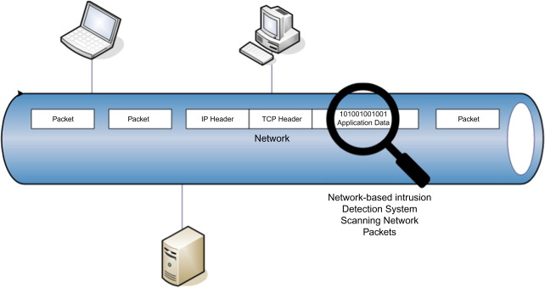
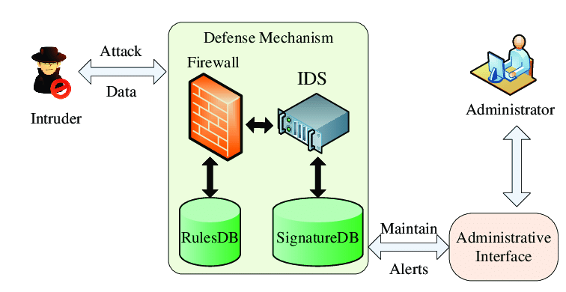
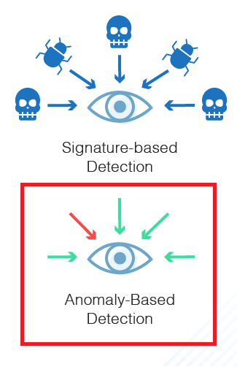
Intrusion Detection Systems
Intro (1/2) cont.
Intrusion Detection Systems (IDS):
Network IDS (NIDS)
Host IDS (HIDS)
Two types:
Signature-Based
Anomaly-Based

Slide 4



Anomaly-Based IDS
Intro (2/2)
IDS + Deep Learning = Anomaly-Based IDS
Challenges:
Enhancing real-life datasets
Applying more accurate Hybrid Deep Learning Methods
High Network Traffic
Client-Sided Machine Learning IDS for Mobile Devices
Malicious attacks are constantly changing

Slide 5
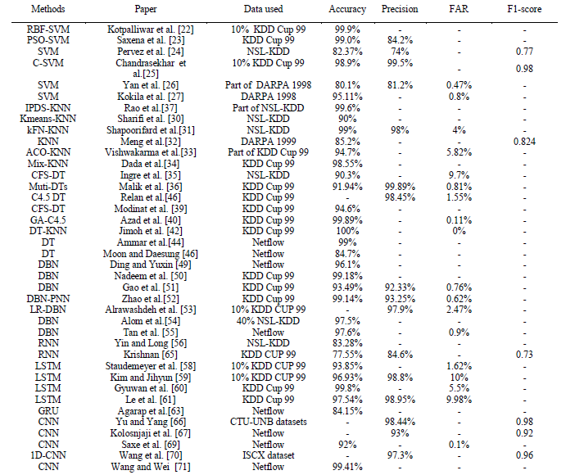
Machine Learning and Deep Learning Methods for Cybersecurity
Related Work (1/2)
A comparative study of the used ML and DL methods in IDS.
Dataset | Classes | Sub Classes
KDD - 99 | 5 | 38
NSL KDD | 5 | 38
DARPA 1998 | 5 | 38
CTU-13 (CTU-UNB) | 2 | 13

Slide 6
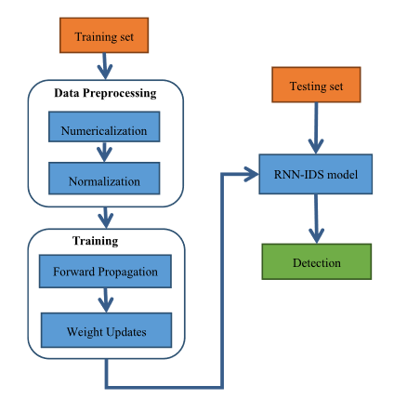
A Deep Learning Approach for Intrusion Detection Using Recurrent Neural Networks
Related Work (2/2)
Method used: Recurrent Neural Networks (RNN)
Dataset: NSL-KDD
Detection of the 5 classes
Accuracy: 97.09%
Offline Detection

Slide 7


Problem Statement
Lack of an enhanced Hybrid Deep Learning Intrusion Detection System with enhanced accuracy and enhanced datasets.

Slide 8
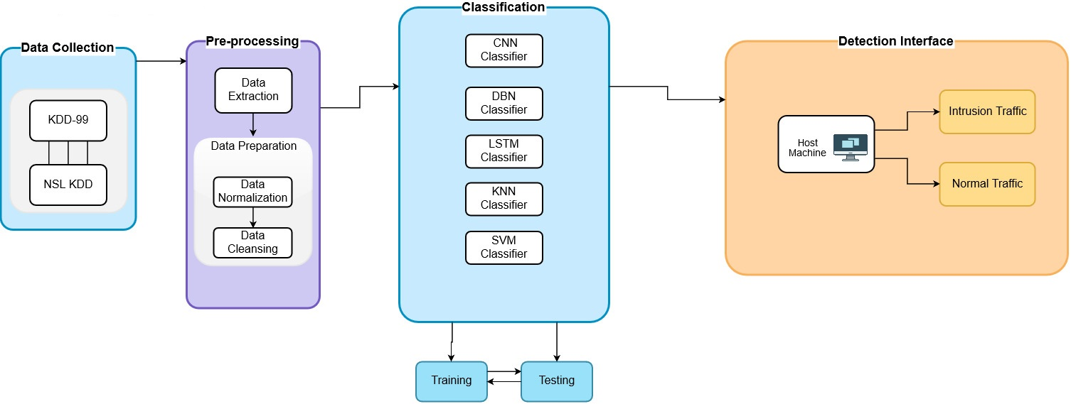
System Overview

Slide 9
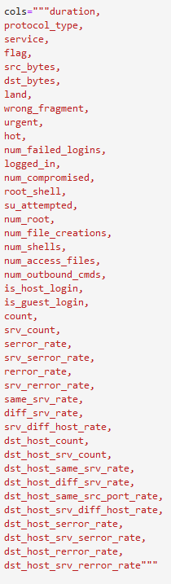
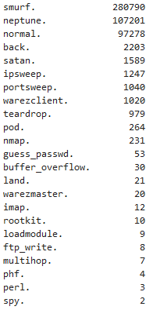
Data Collection
KDD-99 Dataset:
Real-life network packets
Most widely used dataset
41 features
4.9 million packets
Features:
Attack Types & Frequency:

Slide 10
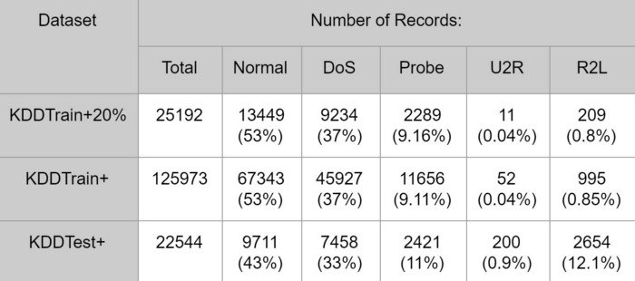
Data Collection
NSL-KDD Dataset:
Iteration of the KDD-99
Tries to solve kdd-99 problems
No redundant records
Features:
Attack Types & Frequency:

Slide 11
Pre-processing
Data Extraction: KDD-99 is a public dataset (http://kdd.ics.uci.edu/databases/kddcup99/kddcup99.html)
Cleansing null packets
Finding categorical features
Visualization & data correlation
Feature mapping

Slide 12
Pre-processing (cont.):
Previous work has followed similar methods in pre-processing of data:
Numericalization of categorical data (label/one-hot encoding)
Normalization of highly variant data (logarithmic scaling)

Slide 13
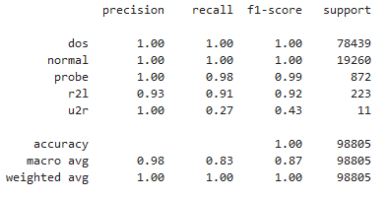

Classification
K-Nearest Neighbor Classifier
SVM
LSTM
KNN Primitive Results (0.33 test-to-train ratio):

Slide 14
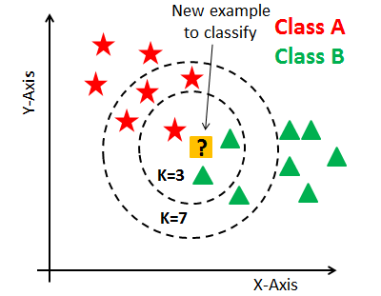
K-Nearest Neighbor Classifier
Supervised learning model
Uses k-closest training samples in feature space
Known as Lazy Learning model

Slide 15
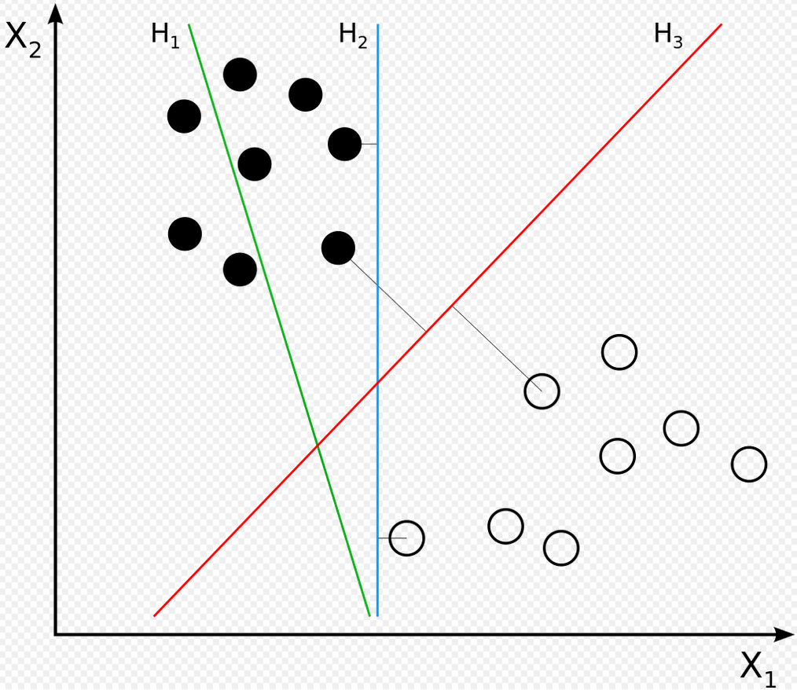
Support Vector Machines (SVM)
Supervised learning model
Creates a separating margin for classification
New data is classified based on whether it exceeds the determined threshold margin

Slide 16
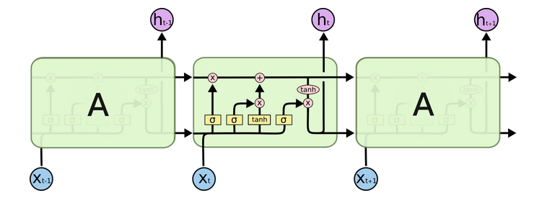
Long Short-term Memory
A type of Recurrent Neural Network
Short-term memory learns short chains of data recurrently
Uses Long memory to store learned relevant information

Slide 17
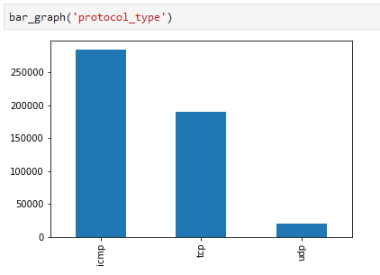
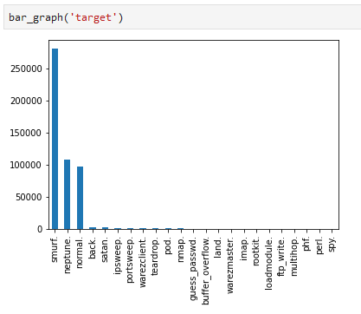
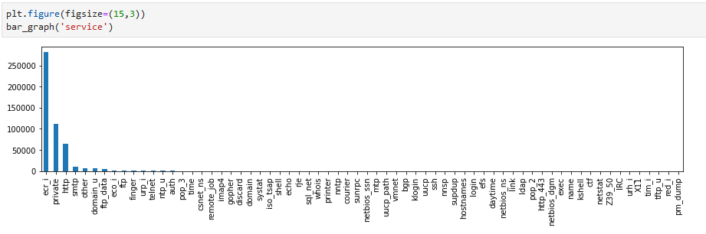
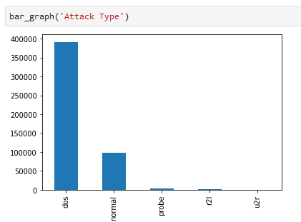
Pre-Experiment
Pre-processing:
Visualizations
Numericalization (Label Encoding) of 3 categorical features

Slide 18
Pre-Experiment
K-Nearest Neighbors:
Used 0.33 Test-to-Train ratio
3 Nearest Neighbors
10% of KDD-99 Dataset
Training Time: 139 seconds
Testing Time: 281 seconds
Accuracy: 99.9%

Slide 19
User Interface:
The users of the system can be multi-levels:
System Administrators
General Audience Individuals
Security Engineers testing attacks
Governmental Agencies taking security measures
Interface shall preview reports including:
Normal/Attack packets
Type of attack in packet
Time and frequency of attacks
Trends in attack frequency
Usual attack sources

Slide 20
Draft slide (this slide is hidden in presentation view)
Provide a system that uses:
Best accuracy ML method + 1 Dataset
Hybrid ML (2 methods) + 1 Dataset
Hybrid ML (2 methods) + 2 Datasets
Hybrid ML Solution on Mobile Devices

